Slide 1
Partial Derivative
Chapter 13

Slide 2
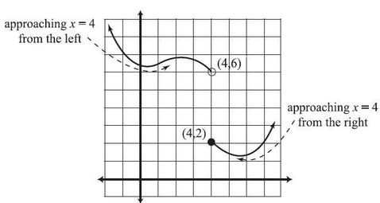
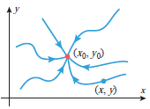
Limits

Slide 3


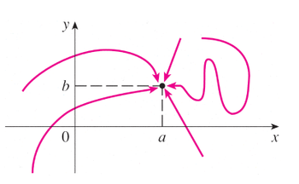
Limits

Slide 4
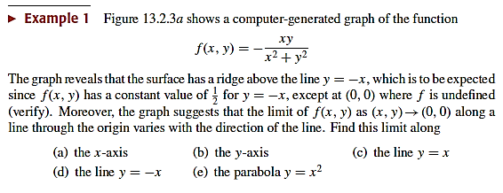
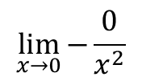

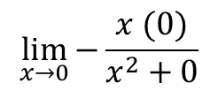





$$Find \lim_{\left(x,y\right)→(0,0)}{−\frac{xy}{x^{2}+y^{2}}}$$
$$=\frac{0}{0}$$
$$\lim_{x→0}{0}$$
$$a) Along x−axis (y=0)$$
$$Put y=0$$
$$=0$$
$$\lim_{x→0}{−\frac{x (0)}{x^{2}+0}}$$
I𝜃 is consis𝜃en𝜃
$$\lim_{x→0}{−\frac{0}{x^{2}}}$$

Slide 5
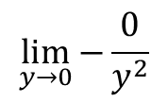

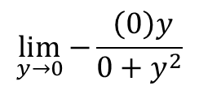


$$Find \lim_{\left(x,y\right)→(0,0)}{−\frac{xy}{x^{2}+y^{2}}}$$
$$\lim_{y→0}{0}$$
$$a) Along y−axis (x=0)$$
$$Put x=0$$
$$=0$$
$$\lim_{y→0}{−\frac{ \left(0\right)y}{0+y^{2}}}$$
I𝜃 is consis𝜃en𝜃
$$\lim_{y→0}{−\frac{0}{y^{2}}}$$

Slide 6
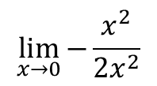

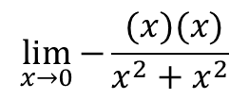
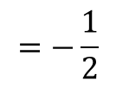

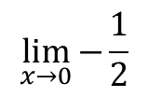
$$Find \lim_{\left(x,y\right)→(0,0)}{−\frac{xy}{x^{2}+y^{2}}}$$
$$\lim_{x→0}{−\frac{1}{2}}$$
c$) Along y=x)$
$$Put y=x$$
$$=−\frac{1}{2}$$
$$\lim_{x→0}{−\frac{ (x)(x)}{x^{2}+x^{2}}}$$
I𝜃 is consis𝜃en𝜃
$$\lim_{x→0}{−\frac{x^{2}}{{2x}^{2}}}$$

Slide 7
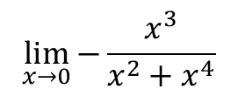


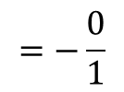
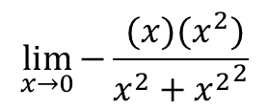
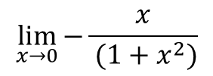
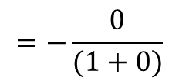

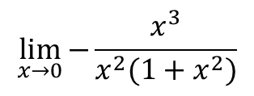
$$Find \lim_{\left(x,y\right)→(0,0)}{−\frac{xy}{x^{2}+y^{2}}}$$
$$\lim_{x→0}{−\frac{x^{3}}{x^{2}(1+x^{2})}}$$
$$a) Along y=x^{2}$$
$$Put y=x^{2}$$
$$\lim_{x→0}{−\frac{x}{ (1+x^{2})}}$$
$$\lim_{x→0}{−\frac{ (x)(x^{2})}{x^{2}+{x^{2}}^{2}}}$$
$$=−\frac{0}{(1+0)}$$
$$\lim_{x→0}{−\frac{x^{3}}{x^{2}+x^{4}}}$$
$$=−\frac{0}{1}$$
$$=0$$
I𝜃 is consis𝜃en𝜃

Slide 8
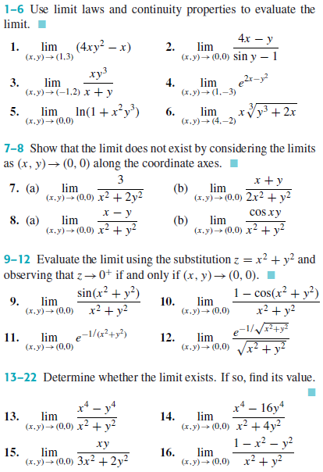
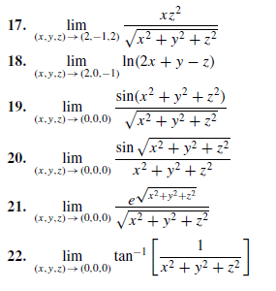

Slide 9
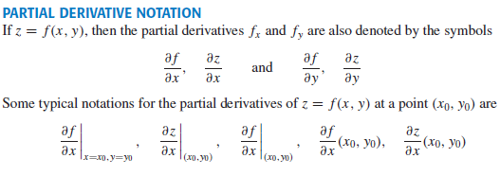
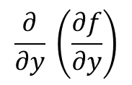



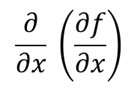
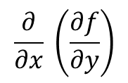



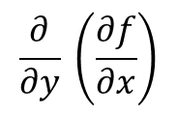
$$\frac{∂f}{∂x}=\frac{∂z}{∂x}=f_{x}$$
$$\frac{∂}{∂x} \left(\frac{∂f}{∂x}\right)$$
$$=\frac{∂^{2}f}{∂x^{2}}=\frac{∂^{2}z}{∂x^{2}}=f_{xx}$$
$$\frac{∂}{∂y} \left(\frac{∂f}{∂x}\right)$$
$$=\frac{∂^{2}f}{∂y∂x}=f_{xy}$$
$$\frac{∂}{∂x} \left(\frac{∂f}{∂y}\right)$$
$$=\frac{∂^{2}f}{∂x∂y}=f_{yx}$$
$$\frac{∂f}{∂y}=\frac{∂z}{∂y}=f_{y}$$
$$\frac{∂}{∂y} \left(\frac{∂f}{∂y}\right)$$
$$=\frac{∂^{2}f}{∂y^{2}}=\frac{∂^{2}z}{∂y^{2}}=f_{yy}$$

Slide 10








$$\frac{∂}{∂x}$$
$$=2 \left(3x^{2}\right)y^{2}+0+4$$
$$\frac{∂}{∂y}$$
$=2 x^{3} (2y)+2+$ 0

Slide 11
Activity

Slide 12






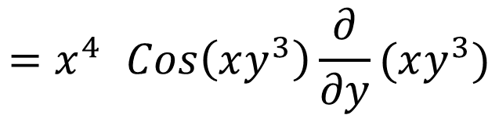

$${=x}^{4} Cos\left(xy^{3}\right)\frac{∂}{∂y}(xy^{3})$$
$${=x}^{4} Cos\left(xy^{3}\right)(x.3y^{2})$$

Slide 13
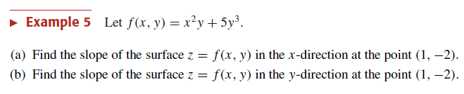
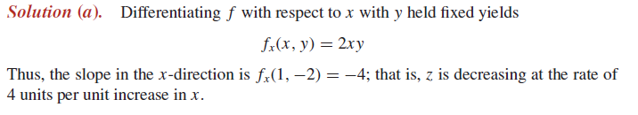
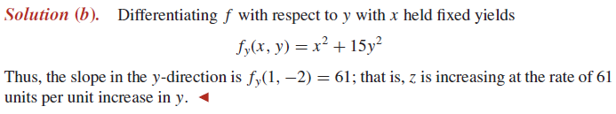

Slide 14
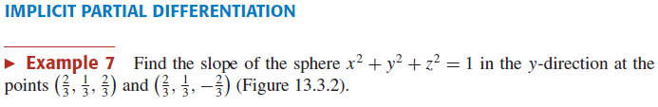






Slide 15
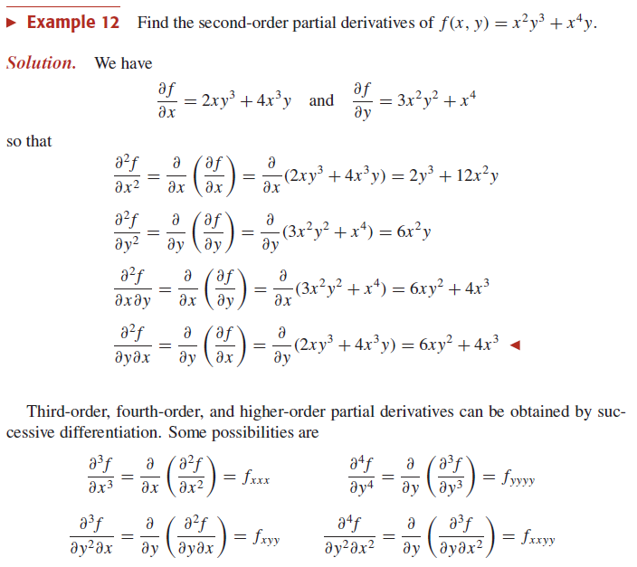

Slide 16






$$f= y^{2}e^{x}+y$$
$$f_{x}= y^{2}e^{x}+0=y^{2}e^{x}$$
$$f_{x}= y^{2}e^{x}$$
$$f_{xy}=2ye^{x}$$
$$f_{xyy}=2e^{x}$$

Slide 17


Slide 18

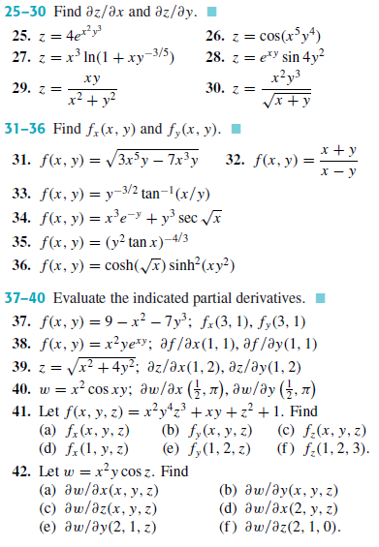
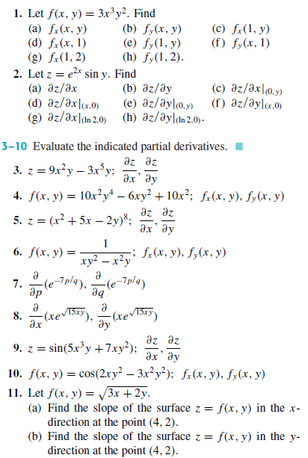

Slide 20
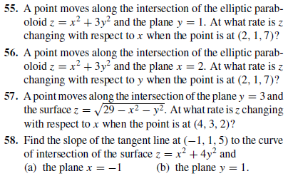
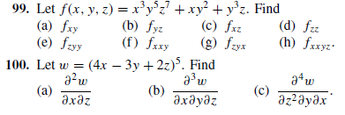

Slide 21
Activity

Slide 22

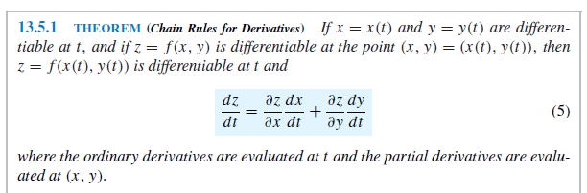

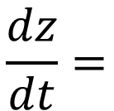



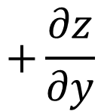


$$z=f(x,y)$$
$$x=x(t)$$
$$y=y(t)$$
$$\frac{dz}{dt}=$$
$$\frac{∂z}{∂x}$$
$$\frac{dx}{dt}$$
$$+\frac{∂z}{∂y}$$
$$\frac{dy}{dt}$$

Slide 23
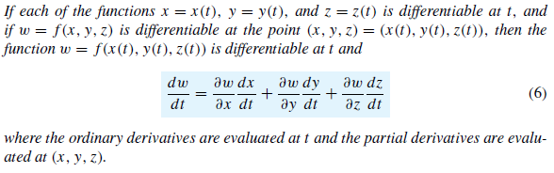
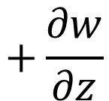



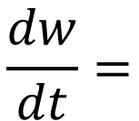
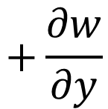

$$w=f(x,y,z)$$
$$x=x(t)$$
$$y=y(t)$$
$$z=z(t)$$
$$\frac{dw}{dt}=$$
$$\frac{∂w}{∂x}$$
$$\frac{dx}{dt}$$
$$+\frac{∂w}{∂y}$$
$$\frac{dy}{dt}$$
$$+\frac{∂w}{∂z}$$
$$\frac{dz}{dt}$$

Slide 24
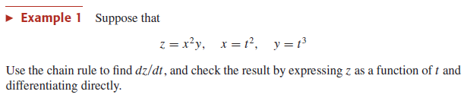



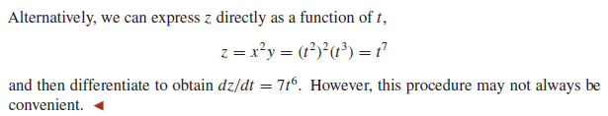



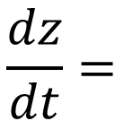



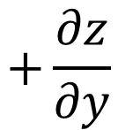
$$z=f(x,y)$$
$$x=x(t)$$
$$y=y(t)$$
$$\frac{dz}{dt}=$$
$$\frac{∂z}{∂x}$$
$$\frac{dx}{dt}$$
$$+\frac{∂z}{∂y}$$
$$\frac{dy}{dt}$$
$$=2\left(t^{2}\right)\left(t^{3}\right)\left(2t\right)+({\left(t^{2}\right)}^{2})(3t^{2})$$

Slide 25
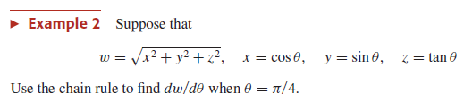




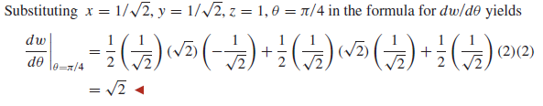




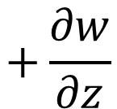
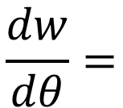





$$w=f(x,y,z)$$
$$x=x(θ)$$
$$y=y(θ)$$
$$z=z(θ)$$
$$\frac{dw}{dθ}=$$
$$\frac{∂w}{∂x}$$
$$\frac{dx}{dθ}$$
$$+\frac{∂w}{∂y}$$
$$\frac{dy}{dθ}$$
$$+\frac{∂w}{∂z}$$
$$\frac{dz}{dθ}$$

Slide 26



Slide 28

Directional derivative

Slide 29








$$U=Cosθ i+Sinθ j$$
$$f=e^{xy}$$
$$f_{x}=e^{xy} \frac{∂}{∂x}(xy)$$
$$f_{x}=e^{xy} \left(1\right)y$$
$$f_{x}={ye}^{xy}$$

Slide 30




Slide 31



Slide 32


Slide 33



Slide 34




Slide 35
Activity

Slide 36




TANGENT PLANES AND NORMAL VECTORS TO LEVEL SURFACES F(x, y, z) = c
$$z=x^{2}+y^{2}$$
$$f(x,y)=x^{2}+y^{2}$$
$$F\left(x,y,z\right)=x^{2}+y^{2}−z$$

Slide 37





Slide 38


Slide 39
Z
(0,0,1)
Y
X

Slide 40


Slide 41



Slide 42

Not recommended

Slide 43
Activity

Slide 44



Slide 45


Slide 46



Slide 47




Slide 48








Slide 49









$$y={\left(y^{3}\right)}^{3}$$
$$y−y^{9}=0$$
$$y (1−y^{8})=0$$
$$y=0, y^{8}=1$$
$$\left(0, 0\right), \left(1, 1\right), (−1,−1)$$
$$y=0, y=±1$$

Slide 50








$$f_{xx}=−12 x^{2}$$
$$f_{xy}=4$$
$$f_{yy}=−12y^{2}$$
$$f=4xy−x^{4}−y^{4}$$
$$f_{x}=4y−4 x^{3}$$
$$f_{xy}=$$

Slide 51
Activity

Slide 52



